Slide 1
C/C++ Programming in a UNIX Environment
CS 3377
Bhanu Kapoor, PhD
Department of Computer Science University of Texas, Dallas, TX bhanu.kapoor@utdallas.edu
Notes Week 05
1

Slide 2
Reading for Week 05
□ Chapter 4, 6, and 7 of A Practical Guide to Linux® Commands, Editors, and Shell Programming, Third Edition. Mark G. Sobell.
◼ Chapter 4: The File System
1

Slide 3
The File System
Define hierarchical filesystem, ordinary file, directory file, home directory, working directory, and parent directory
List best practices for filenames
Determine the name of the working directory
Explain the difference between absolute and relative pathnames
Create and remove directories
List files in a directory, remove files from a directory, and copy and
move files between directories
List and describe the uses of standard Linux directories and files
Display and interpret file and directory ownership and permissions
Modify file and directory permissions
Expand access control using ACLs
Describe the uses, differences, and methods of creating hard links and symbolic links
1

Slide 4
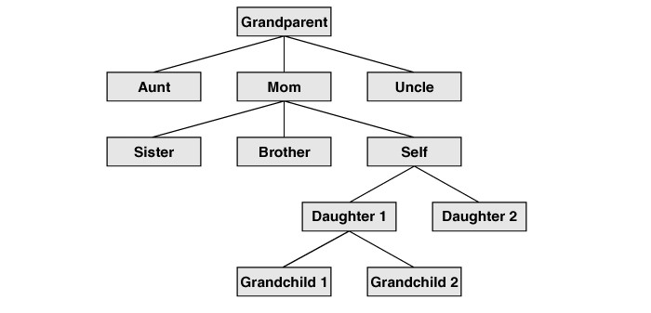
Hierarchical File System
1

Slide 5
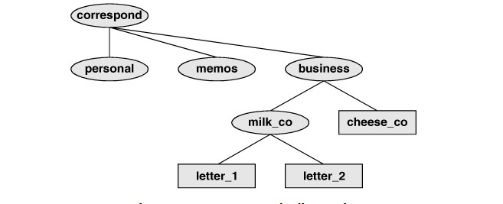
Directories
1

Slide 6
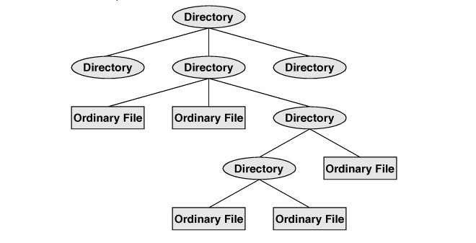
Directory Files and Ordinary Files
1

Slide 7
Filenames
For filenames, choose characters from the following list:
Uppercase letters (A–Z)
Lowercase letters (a–z)
Numbers (0–9)
Underscore (_)
Period (.)
Comma (,)
Filename extensions
helloworld.c
story.txt
□ Hidden Filenames
7

Slide 8
Working Directory
□ login: max
Password:
Last login: Wed Oct 20 11:14:21 from 172.16.192.150
$ pwd
/home/max
Startup Files
$ls –a
Pathnames
$/ (root)

Slide 9
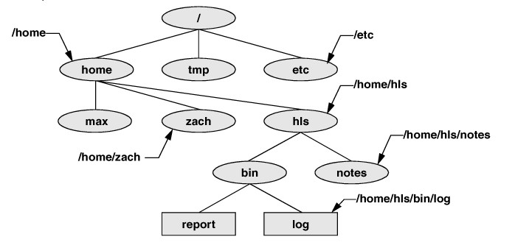
Pathnames
□ Absolute and Relative Pathnames
$~/ another form of absolute pathname
$ls → relative pathnames

Slide 10
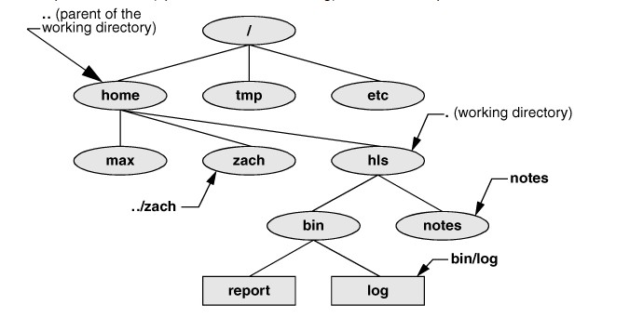
Relative Pathnames

Slide 11
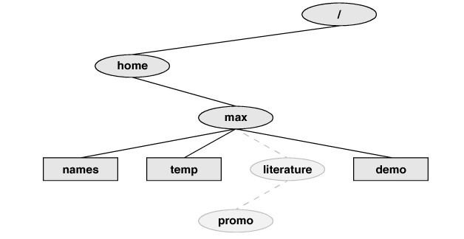
Creating a Directory
$ mkdir <directory name>
$ pwd
◼ /home/max
$ mkdir literature
$ls F

Slide 12
Changing a Directory
□ $ cd /home/max/literature
$ pwd
/home/max/literature
$ cd
$ pwd
/home/max
$ cd literature
$ pwd
/home/max/literature
The . and .. Directory Entries
$ pwd
/home/max/literature
$ ls ..
demo literature names temp
12

Slide 13
Deleting a Directory
$ rmdir /home/max/literature/promo
The rm utility has a –r option
Recursively deletes, be careful using it
Touch creates empty file
$ cd
$ pwd
/home/max
$ touch letter

Slide 14
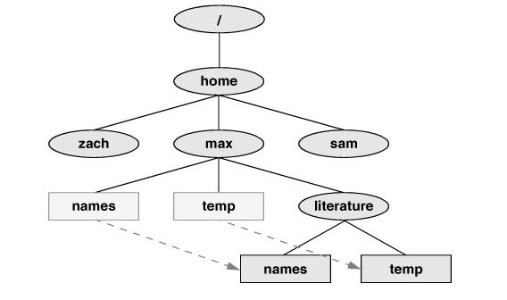
Move Files
$mv names temp literature
mv existing-file-list directory
mv existing-directory-list new-directory

Slide 15
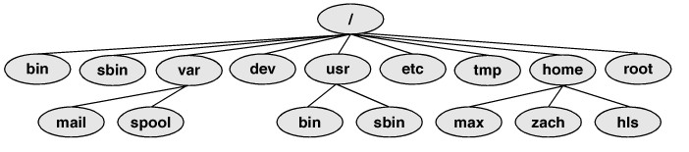
Standard Directories

Slide 16
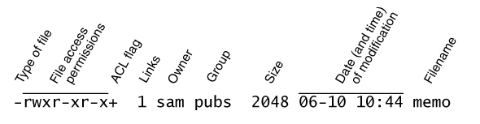
Access Permissions
ls –l: Displays Permissions
$ ls -l check_spell letter.0210
-rwxr-xr-x. 1 sam pubs 766 03-21 14:02 check_spell
-rw-r--r--. 1 sam pubs 6193 02-10 14:22 letter.0210

Slide 17
Change Access Permissions
□ $ ls -l letter.0210
-rw-r-----. 1 sam pubs 6193 02-10 14:22 letter.0210
$ chmod a+rw letter.0210
$ ls -l letter.0210
-rw-rw-rw-. 1 sam pubs 6193 02-10 14:22 letter.0210
□ $ ls -l check_spell
-rwxr-xr-x. 1 sam pubs 766 03-21 14:02 check_spell
$ chmod o-rx check_spell
$ ls -l check_spell
-rwxr-x---. 1 sam pubs 766 03-21 14:02
check_spell

Slide 18
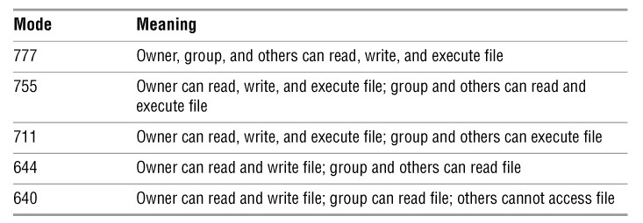
Numeric Arguments
□ $ chmod 600 letter.0210
$ ls -l letter.0210
-rw-------. 1 sam pubs 6193 02-10 14:22
letter.0210
$ ls -ld /home/max/info
drwx-----x. 2 max pubs 4096 08-21 09:31 /home/max/info
$ chmod o+r /home/max/info

Slide 19
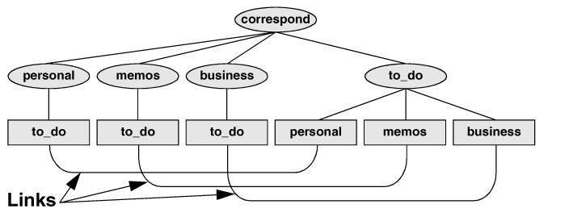
Links
ln existing-file new-link
Creates a hard link

Slide 20
Hard Links
□ $ cat file_a
This is file A.
$ ln file_a file_b
$ cat file_b
This is file A.
$ vim file_b
...
$ cat file_b
This is file B after the change.
$ cat file_a
This is file B after the change.
How is different from cp?
$ ls -l file_a file_b file_c file_d
$ ls -i file_a file_b file_c file_d

Slide 21
Symbolic Links
□ $ ln --symbolic /home/max/sum /tmp/s3
$ ls -l /home/max/sum /tmp/s3
-rw-rw-r--. 1 max pubs 38 06-12 09:51
/home/max/sum
lrwxrwxrwx. 1 max pubs 13 06-12 09:52 /tmp/s3 ->
/home/max/sum
$ cat /tmp/s3
This is sum.
□ $ pwd
/home/max
$ ln --symbolic sum /tmp/s4
$ ls -l /home/max/sum /tmp/s4
lrwxrwxrwx. 1 max pubs 3 06-12 10:13 /tmp/s4 -> sum
-rw-rw-r--. 1 max pubs 38 06-12 09:51
/home/max/sum
$ cat /tmp/s4
cat: /tmp/s4: No such file or directory
21

